Slide 1
Job Portal Management System
TEAM MEMBERS
R. Naga Venkata Kusumitha
K. Lavanya Priya
L. Pravallika
G. Ahalya

Slide 2
WHY THIS PROJECT
Problem Statement
Core Entities
Objective
Job seekers, employers, job postings, applications and interviews are often scattered across spreadsheets or disconnected tools — making it hard to track an application's journey, or to report on hiring activity.
C
Candidates
Job seekers registered on the portal
E
Employers
Design and implement a Job Portal database using MySQL to manage candidates, employers, jobs, applications and interviews.
Companies posting job openings
J
Jobs
Track candidates and employers in a single, consistent system
Postings created by employers
Link every job posting to its employer and manage openings
A
Applications
Record each application's status, from Applied to Selected/Rejected
Candidate applications to jobs
Schedule and log interview outcomes tied to each application
Enable joins, views, procedures & triggers for reporting and automation
I
Interviews
Interview records tied to applications

Slide 3
SCHEMA
Database Design
Table | Columns (PK / FK / constraints)
Candidates | candidate_id PK, full_name, phone UNIQUE, email UNIQUE, city
Employers | employer_id PK, company_name, industry
Jobs | job_id PK, employer_id FK, title, location, salary
Applications | application_id PK, candidate_id FK, job_id FK, application_date, status
Interviews | interview_id PK, application_id FK, interview_date, mode, result

Slide 4
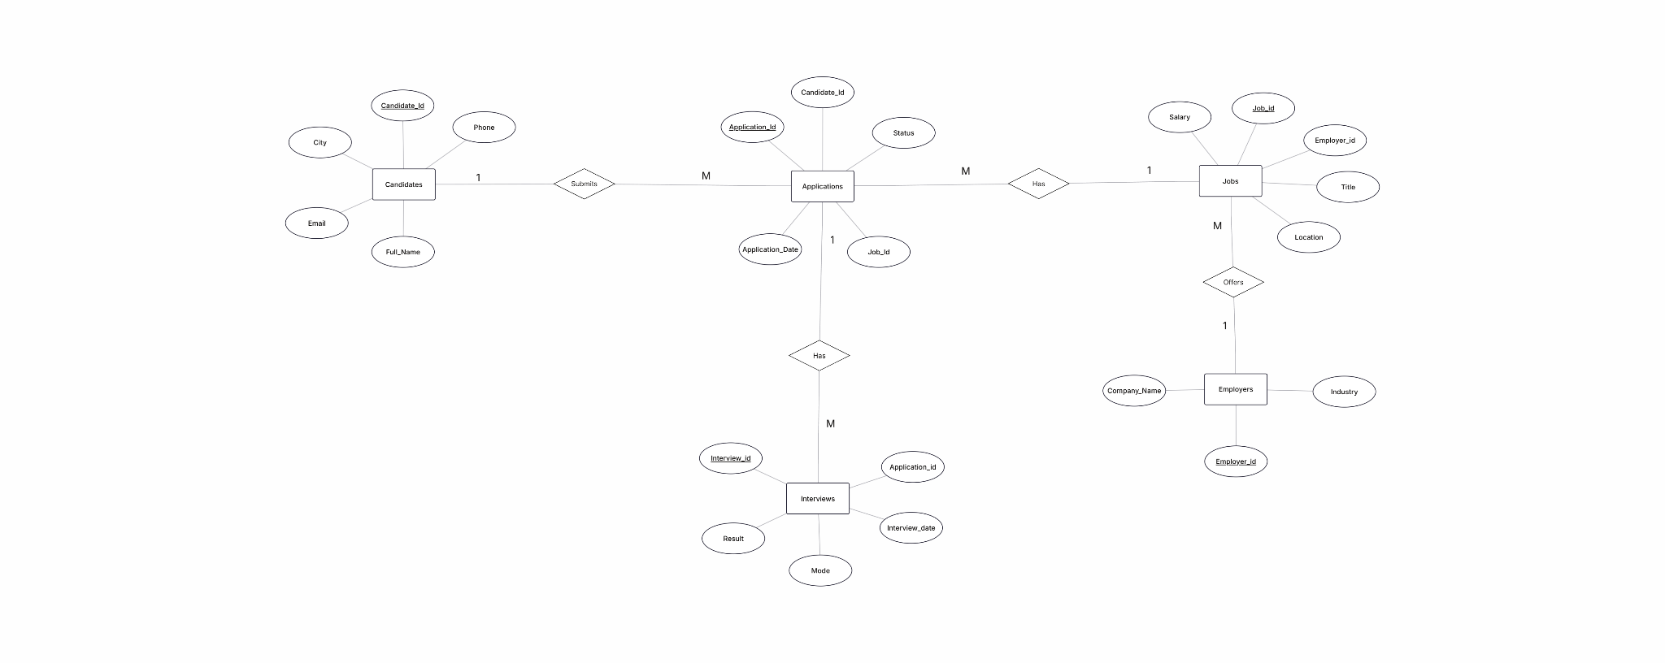
SCHEMA
Database Design — ER Diagram
Employers (1) → Jobs (M)
Candidates (1) → Applications (M)
Jobs (1) → Applications (M)
Applications (1) → Interviews (M)
Five normalized tables connected by primary and foreign keys — Candidates, Employers, Jobs, Applications and Interviews.

Slide 5
SAMPLE DATA
Sample Data — Candidates, Employers & Jobs
Candidates
Employers
candidate_id | full_name | phone | email | city
1 | Aarav | 900000001 | c1@mail.com | Hyderabad
2 | Bhavya | 900000002 | c2@mail.com | Vijayawada
3 | Charan | 900000003 | c3@mail.com | Vizag
4 | Divya | 900000004 | c4@mail.com | Guntur
5 | Esha | 900000005 | c5@mail.com | Warangal
6 | Farhan | 900000006 | c6@mail.com | Nellore
7 | Gopi | 900000007 | c7@mail.com | Kurnool
8 | Hari | 900000008 | c8@mail.com | Tirupati
9 | Isha | 900000009 | c9@mail.com | Chennai
10 | John | 900000010 | c10@mail.com | Bengaluru
employer_id | company_name | industry
101 | TechNova | IT
102 | DataWave | Analytics
103 | CloudEdge | Cloud
104 | FinCore | Finance
105 | HealthSoft | Healthcare
Jobs
job_id | employer_id | title | location | salary
1001 | 101 | Python Developer | Hyderabad | 650000
1002 | 101 | SQL Developer | Hyderabad | 550000
1003 | 102 | Data Analyst | Vizag | 600000
1004 | 103 | Cloud Engineer | Bengaluru | 850000
1005 | 104 | BI Developer | Chennai | 700000
1006 | 105 | ML Engineer | Hyderabad | 950000

Slide 6
SAMPLE DATA
Sample Data — Applications & Interviews
Applications
Interviews
application_id | candidate_id | job_id | application_date | status
1 | 1 | 1001 | 2026-07-01 | Applied
2 | 2 | 1003 | 2026-07-02 | Shortlisted
3 | 3 | 1002 | 2026-07-02 | Rejected
4 | 4 | 1004 | 2026-07-03 | Interview
5 | 5 | 1005 | 2026-07-03 | Selected
6 | 6 | 1006 | 2026-07-04 | Applied
7 | 7 | 1001 | 2026-07-05 | Interview
8 | 8 | 1002 | 2026-07-06 | Shortlisted
9 | 9 | 1004 | 2026-07-07 | Applied
10 | 10 | 1006 | 2026-07-08 | Selected
interview_id | application_id | interview_date | mode | result
201 | 2 | 2026-07-05 | Online | Pending
202 | 4 | 2026-07-06 | Offline | Pending
203 | 5 | 2026-07-07 | Online | Selected
204 | 7 | 2026-07-08 | Offline | Rejected
205 | 8 | 2026-07-09 | Online | Pending
206 | 10 | 2026-07-10 | Offline | Selected

Slide 7
QUERY TYPE · JOINS
Multi-Table Joins
Query #28
Interview details with candidate & company information
SELECT i.interview_id, c.full_name, e.company_name, j.title,
i.interview_date, i.mode, i.result
FROM Interviews i
JOIN Applications a ON i.application_id = a.application_id
JOIN Candidates c ON a.candidate_id = c.candidate_id
JOIN Jobs j ON a.job_id = j.job_id
JOIN Employers e ON j.employer_id = e.employer_id;
A four-way join chains Interviews → Applications → Candidates / Jobs → Employers into one readable report row.
interview_id | full_name | company_name | title | interview_date | mode | result
202 | Divya | CloudEdge | Cloud Engineer | 2026-07-06 | Offline | Pending
203 | Esha | FinCore | BI Developer | 2026-07-07 | Online | Selected
204 | Gopi | TechNova | Python Developer | 2026-07-08 | Offline | Rejected
205 | Hari | TechNova | SQL Developer | 2026-07-09 | Online | Pending
206 | John | HealthSoft | ML Engineer | 2026-07-10 | Offline | Selected
Output: 5 rows returned

Slide 8
QUERY TYPE · VIEWS
Views
Query #32-34
View: Selected_Candidates
View: active_job_postingss
CREATE VIEW Selected_Candidates AS
SELECT c.full_name, e.company_name, j.title,
j.location, j.salary
FROM Candidates c
JOIN Applications a ON c.candidate_id = a.candidate_id
JOIN Jobs j ON a.job_id = j.job_id
JOIN Employers e ON j.employer_id = e.employer_id
WHERE a.status = 'Selected';
CREATE VIEW active_job_postingss AS
SELECT DISTINCT j.job_id, j.title, j.location, j.salary
FROM Jobs j
JOIN Applications a ON j.job_id = a.job_id
WHERE a.status <> 'Rejected';
SELECT * FROM active_job_postingss;
full_name | company_name | title | location | salary
Esha | FinCore | BI Developer | Chennai | 700000.00
John | HealthSoft | ML Engineer | Hyderabad | 950000.00
Surfaces every job that still has at least one non-rejected application — a live feed of jobs worth reviewing.
V
Views compose complex, repeated joins into a single reusable virtual table — the base query never needs to be retyped for reporting.
Lists candidates whose applications reached 'Selected', joined with employer and job details.
Both views stay read-only projections and refresh automatically as base-table data changes.

Slide 9
DATA SAFETY
Transactions — COMMIT & ROLLBACK
Query #35-36
Scenario A - Update status, then commit
Scenario B - Accidental delete, then rollback
START TRANSACTION;
UPDATE Applications
SET status = 'Interview Scheduled'
WHERE application_id = 4;
COMMIT;
START TRANSACTION;
DELETE FROM Interviews
WHERE application_id = 10;
DELETE FROM Applications
WHERE application_id = 10;
ROLLBACK;
1 row(s) affected · Rows matched: 1, Changed: 0 · COMMIT makes the change permanent.
ROLLBACK undoes both deletes — the interview and application records are fully restored.
Why transactions matter
T
START TRANSACTION groups multiple statements into one atomic unit. COMMIT persists every change together; ROLLBACK reverses every change together — so a status update or a multi-table delete either fully succeeds or leaves no partial trace.
Transactions protect multi-step updates so the database never ends up in a half-changed state.

Slide 10
REUSABLE LOGIC
Stored Procedures
Query #37-38
display_jobs(employer_id)
GetAppByStatus(status)
DELIMITER //
CREATE PROCEDURE display_jobs(IN emp_id INT)
BEGIN
SELECT title, location, salary
FROM Jobs WHERE employer_id = emp_id;
END //
DELIMITER ;
CALL display_jobs(103);
DELIMITER //
CREATE PROCEDURE GetAppByStatus(IN app_status VARCHAR(50))
BEGIN
SELECT * FROM Applications
WHERE status = app_status;
END //
DELIMITER ;
CALL pfs37.GetAppByStatus('applied');
title | location | salary
Cloud Engineer | Bengaluru | 850000.00
application_id | candidate_id | job_id | application_date | status
1 | 1 | 1001 | 2026-07-01 | Applied
6 | 6 | 1006 | 2026-07-04 | Applied
9 | 9 | 1004 | 2026-07-07 | Applied
11 | 1 | 1003 | 2026-09-06 | applied
Returns every job posted by employer 103 (CloudEdge) — 1 row returned.
Returns every application with the given status — 4 rows returned.
P
Stored procedures wrap a parameterized query behind a single CALL — the same lookup logic runs consistently for any employer or status without rewriting SQL.

Slide 11
AUTOMATED AUDITING
Triggers
Query #39-40
trg_application_log · AFTER INSERT ON Applications
trg_interview_archive · BEFORE DELETE ON Interviews
CREATE TRIGGER trg_application_log
AFTER INSERT ON Applications
FOR EACH ROW
BEGIN
INSERT INTO Application_Log
(application_id, candidate_id, job_id, application_date)
VALUES
(NEW.application_id, NEW.candidate_id,
NEW.job_id, NEW.application_date);
END //
CREATE TRIGGER trg_interview_archive
BEFORE DELETE ON Interviews
FOR EACH ROW
BEGIN
INSERT INTO Interview_Archive
(interview_id, application_id, interview_date,
mode, result)
VALUES
(OLD.interview_id, OLD.application_id,
OLD.interview_date, OLD.mode, OLD.result);
END //
log_id | application_id | candidate_id | job_id | application_date
1 | 11 | 1 | 1003 | 2026-09-06
archive_id | interview_id | application_id | interview_date | mode | result
1 | 201 | 2 | 2026-07-05 | Online | Pending
Inserting application #11 auto-logged its details into Application_Log — no application code required.
Deleting interview #201 auto-archived its full record before removal — nothing is lost.
!
Why triggers matter
Triggers fire automatically on INSERT or DELETE events, so auditing and archival happen inside the database itself — every new application is logged and every deleted interview is preserved, with zero extra application-level code.

Slide 12
PROJECT DETAILS
Tech Stack
Component | Technology
Database Engine | MySQL (8.x recommended)
Query Language | SQL (DDL, DML, DCL, TCL)
Procedural Logic | Stored Procedures & Triggers
Diagramming | ER Diagram (Crow's Foot notation)
Client Tools | MySQL Workbench / MySQL CLI

Slide 13
CONCLUSION
A Complete, Query-Ready Job Portal Database
Normalized schema
Five linked tables (Candidates, Employers, Jobs, Applications, Interviews) enforce referential integrity end to end.
1
40 business queries
From basic filters and string/date functions to aggregations, multi-table joins, and outer-join gap analysis.
2
Views for reporting
Selected_Candidates and active_job_postingss package recurring joins into reusable, always-current tables.
3
Automation built in
Transactions guarantee atomic updates; procedures reuse lookup logic; triggers auto-log and auto-archive.
4
Ready to plug into any backend — a pure database-layer implementation with no application code required.

